Slide 1

Sign Language Gestures Recognition
Year 2025

Slide 2
Names
Ahmed Marwan 222100171
Mohamed Yasser 222101451
Shehab Essam 222100828
Wael Ahmed 222101888
Mostafa Karam 222101620

Slide 3

Table of Contents
Introduction
System Design
Model Architecture
Results
Conclusion

Slide 4

Introduction
Language is vital for communication, with ASL serving as a key medium for the deaf and hard-of-hearing. However, barriers like limited interpreters and complex manual translation hinder accessibility.

Slide 5
Introduction
This project proposes a deep learning-based system using CNNs to recognize ASL alphabet gestures, translating them into characters for real-time communication on edge devices. By combining advanced AI techniques with optimized hardware integration,

Slide 6

System Design
The system is structured to ensure accurate ASL alphabet recognition, leveraging both software and hardware components for efficiency and accessibility. It consists of the following key elements:
1. Dataset and Preprocessing
2. Model Architecture
3. Hardware Components
4. Software Components

Slide 7

Dataset and Preprocessing
Dataset Organization: ASL gesture images are stored in labeled folders corresponding to alphabet letters (A–Z) Except (J&Z)
Data Splitting: The dataset is divided into training (70%), validation (15%), and testing (15%) subsets to ensure balanced evaluation.

Slide 8

Dataset and Preprocessing
Image Preprocessing: Images are rescaled to a [0, 1] pixel range for normalization, and one-hot encoding is applied to labels for classification compatibility.
Data Augmentation: Techniques like rotation, flipping, and zooming are used to enrich the dataset and improve model generalization.

Slide 9

Model Architecture
The ASL recognition model is built on a Convolutional Neural Network (CNN), chosen for its effectiveness in image classification. Key components include:
Input Layer: Processes resized and normalized hand gesture images.
Convolutional Layers: Extract spatial features using filters.
Pooling Layers: Reduce feature dimensions to prevent overfitting and improve efficiency.

Slide 10
Model Architecture
Fully Connected Layers: Map extracted features to class predictions.
Output Layer: Uses a softmax activation function to predict probabilities for 24 alphabet classes.
Regularization (dropout) and the Adam optimizer ensure robust performance, while cross-entropy loss guides training for accurate classification.

Slide 11
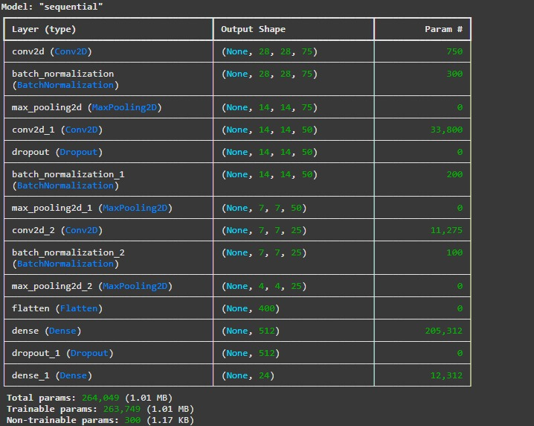
Model Architecture

Slide 12

Hardware Components
ESP-32 CAM Module: Captures hand gesture images, processes them in real time, and supports TensorFlow Lite for edge computing.
Power Supply: A rechargeable battery powers the hardware.
Display: A 16x2 LCD outputs recognized ASL letters, providing immediate feedback.

Slide 13

Software Components
TensorFlow Lite Model: A lightweight version of the trained CNN model for efficient inference on edge devices.
Model Conversion: The CNN model is converted to TensorFlow Lite format for compatibility with the ESP-32 CAM module.

Slide 14

Results

Slide 15
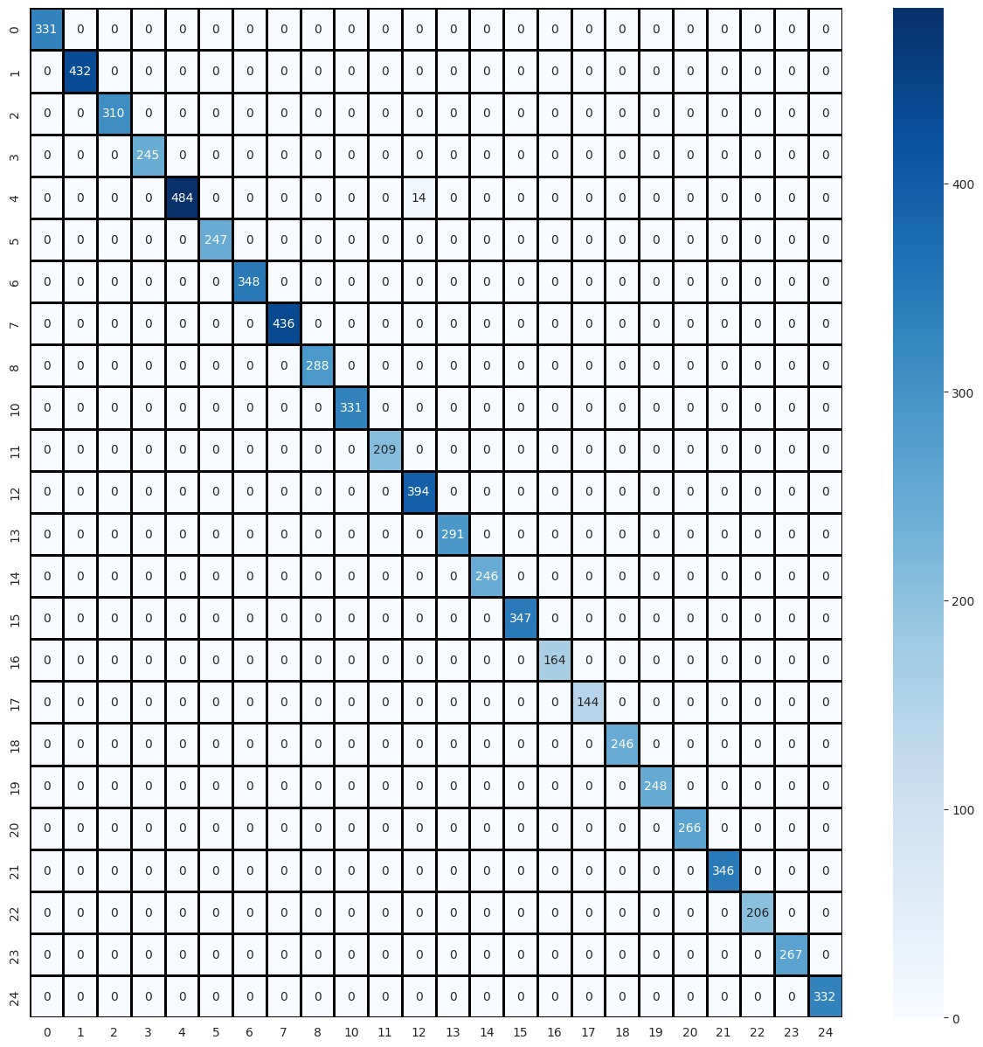
Confusion Matrix

Slide 16
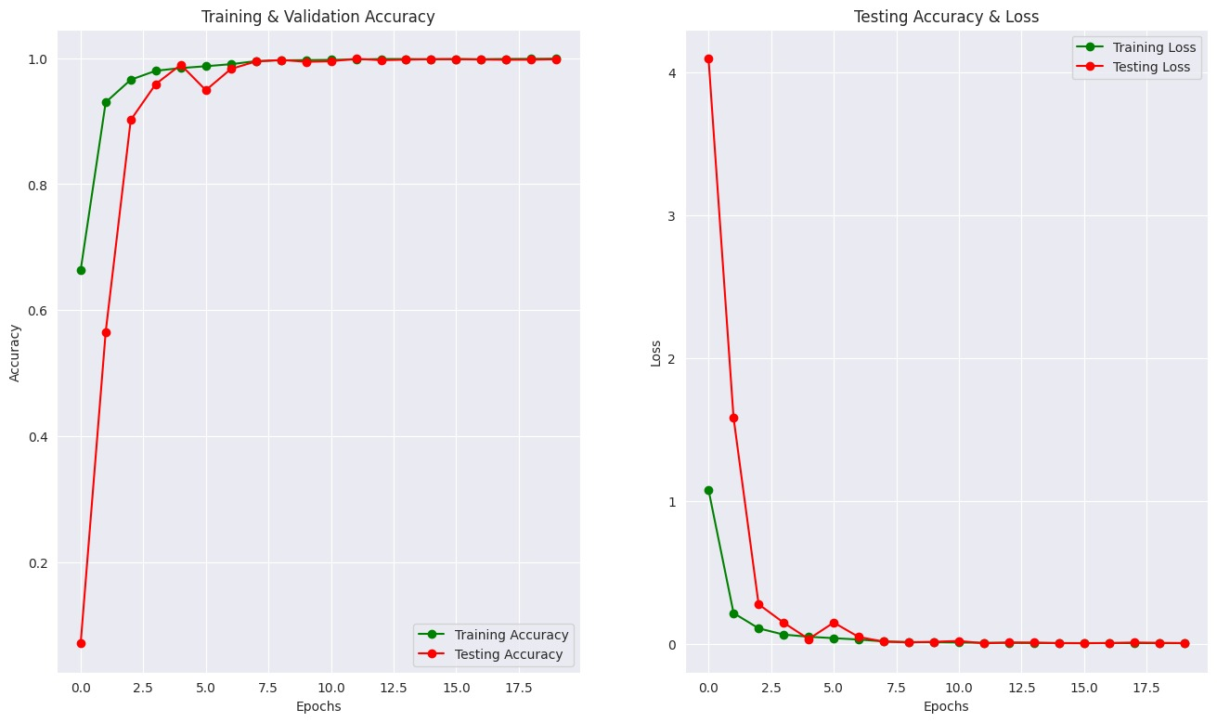
Training Loss and Metrics

Slide 17
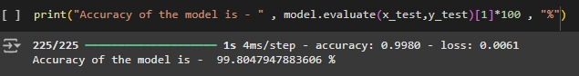
Final Test Accuracy

Slide 18
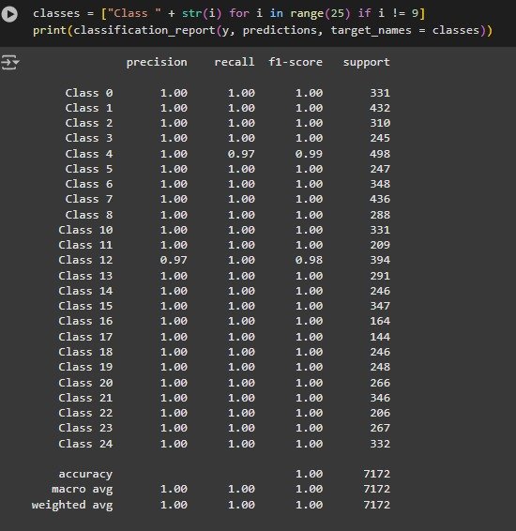
Final Test Accuracy

Slide 19
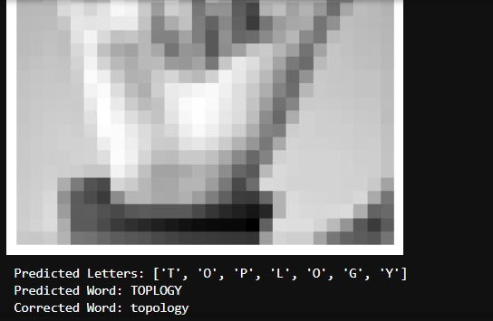
Final Result Test

Slide 20
Conclusion
The project successfully demonstrates the development of a deep learning-based system for recognizing American Sign Language (ASL) alphabets. By employing a Convolutional Neural Network (CNN) architecture, optimized with techniques like data augmentation and dropout, the model achieved notable accuracy in classifying ASL gestures.
This innovation enhances communication accessibility for deaf and hard-of-hearing communities.
Future improvements could include expanding the dataset to dynamic signs And Numbers

Slide 21

Any Questions

Slide 22
Thanks For Your Attention

